Slide 1
Computer Architecture
Prof. Saurabh Gandhi (EEE department)

Slide 2
Introduction
Administratrivia
What is computer architecture?
Historical look at CA
The design of a computer (levels of abstraction)

Slide 3


Administratrivia
Evaluation
Midsemester exam: 25% (50 marks)
Comprehensive exam: 35% (70 marks)
In-class quizzes and attendance: 15% (30 marks)
Labs:
Lab tasks completion: 7.5% (1.5 marks per lab)
Evaluative take-home: 7.5% (1.5 marks per lab)
Lab exam: 10%
Reference books
Patterson and Hennessy, Computer Organization & Design (RISC V edition)
Harris and Harris, Digital Design and Computer Architecture RISC‑V Edition
The elements of computing systems: building a modern computer from first principles
Course page (rbbibcri)
In-class quizzes!
Code: UMGUPO
https://classy-6cf89.web.app

Slide 4
Administratrivia
Course related communication
Email communication will not be considered valid
All communication through Google form only https://forms.gle/HNwq2Dsxo8RRLPPKA (available on course page)
Office hours
Immediately after class is the best time to meet me
Otherwise by appointment (use the form above!)
Make-up
Midsem / comprehensive – as per institute rules (valid documentation required ahead of time, to be submitted via form above!)
Labs – cannot miss unless valid reason (max 1), in which case marks will be scaled
In-class – none

Slide 5
At the end of this course…
You should be able to
Build your own computer!
Understand and explain how a general purpose computer works in terms of building blocks
Explain cool new technologies that make computers faster

Slide 6
And why should I care?
Friday 8 pm: Interact with a recent grad from industry to learn more!
I want to write UPSC. Why bother about CA?
It is funnn! 🙃
If the PM’s computer crashes, you can tell them where the power button is… with authority😮
I want an SDE job. Why bother about CA?
Understanding CA will help you write much more efficient code
Depends on the kind of software you are building…
Cat accessory shopping website… back to the UPSC example 😮‍💨
Data analytics / ML: surely improve your code performance!
OS, embedded, robotics, cloud, compiler development: extremely important
I am a hardcore ELECTRICAL ENGINEER
Indispensable for VLSI design, semiconductor roles

Slide 7
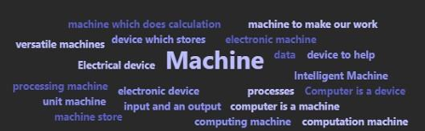
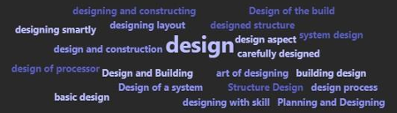
What is computer architecture?
What is a computer?
a computer is an information manipulation system that operates on data according to a set of predefined, stored instructions (a program)
What is architecture?
Architecture is the conceptual framework or underlying structure that organizes complex systems, whether physical (buildings, cities) or digital (software, organizations), to create order, meaning, and functionality
So what is ‘computer architecture?
Computer architecture is the functional design and structure of a computer system. It focuses on how a computer’s hardware components, like the CPU and memory, work together to execute instructions efficiently.

Slide 8
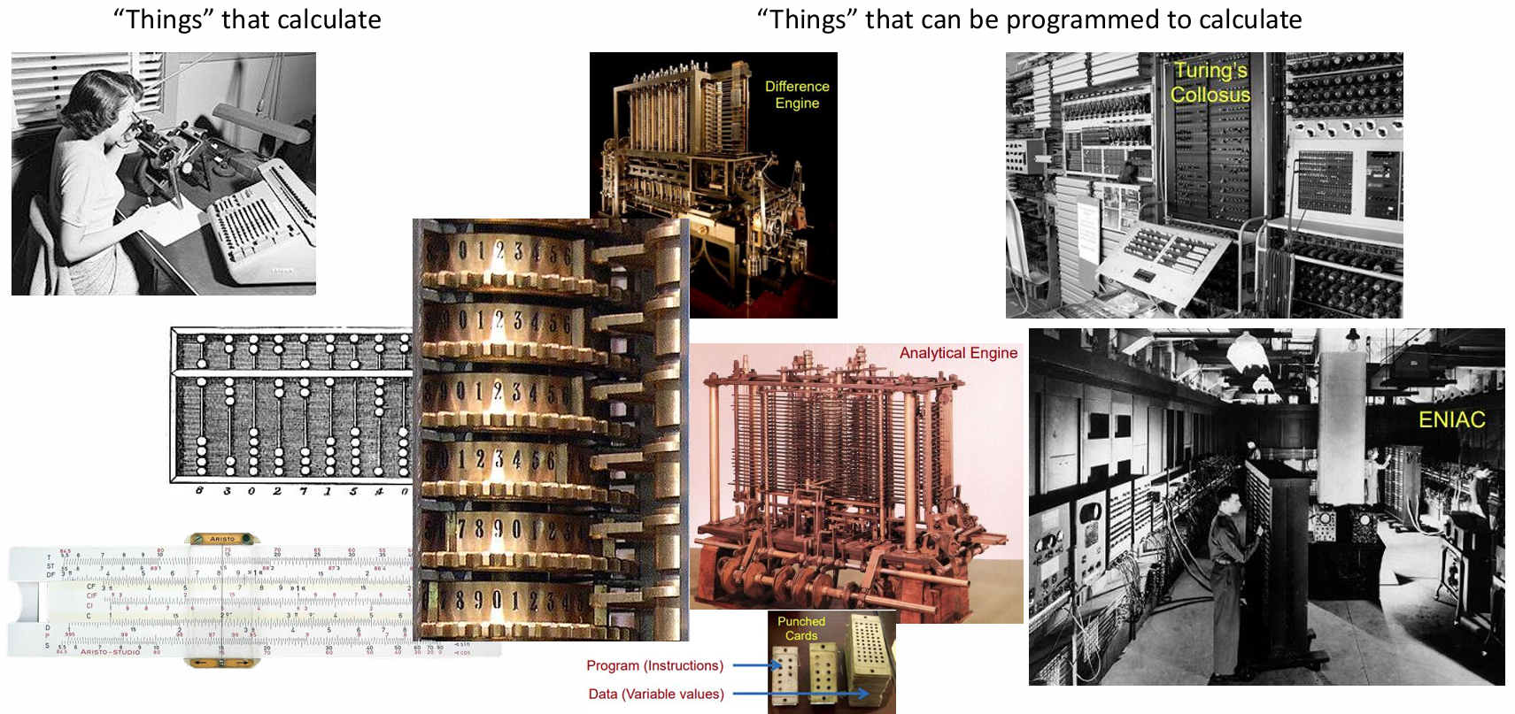
Computers through the ages
Mechanical
Electronic

Slide 9
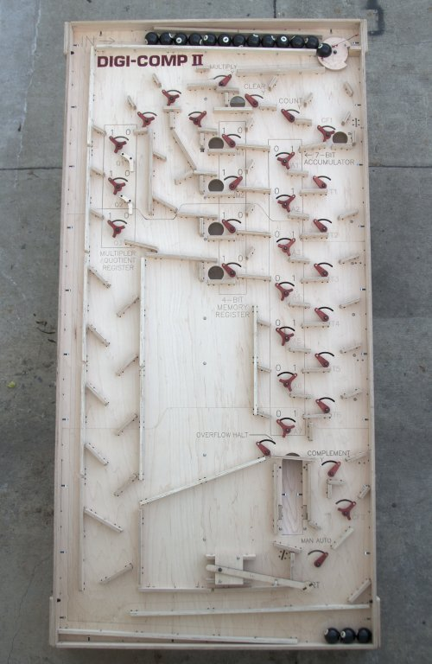
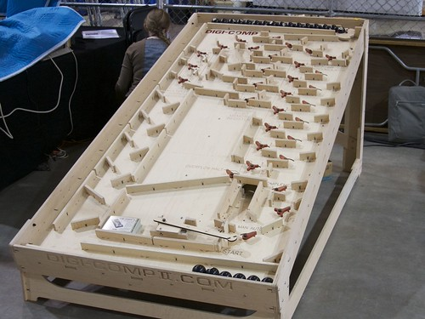

A simple mechanical binary computer
A video introduction to the Digi-Comp II | Evil Mad Scientist Laboratories

Slide 10
How to design a computer?

Slide 11
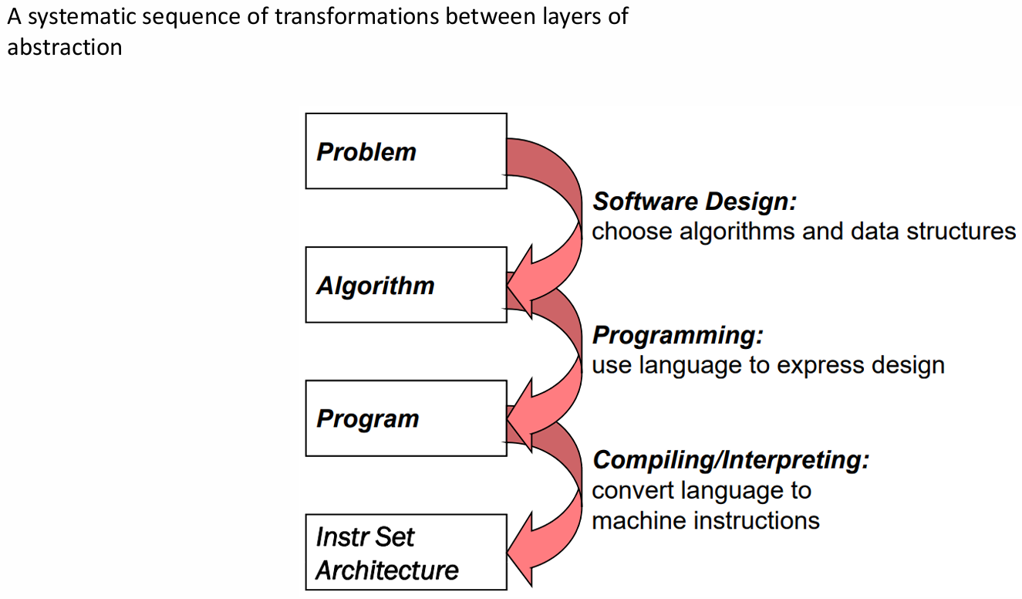
How do we solve a problem using a computer?

Slide 12
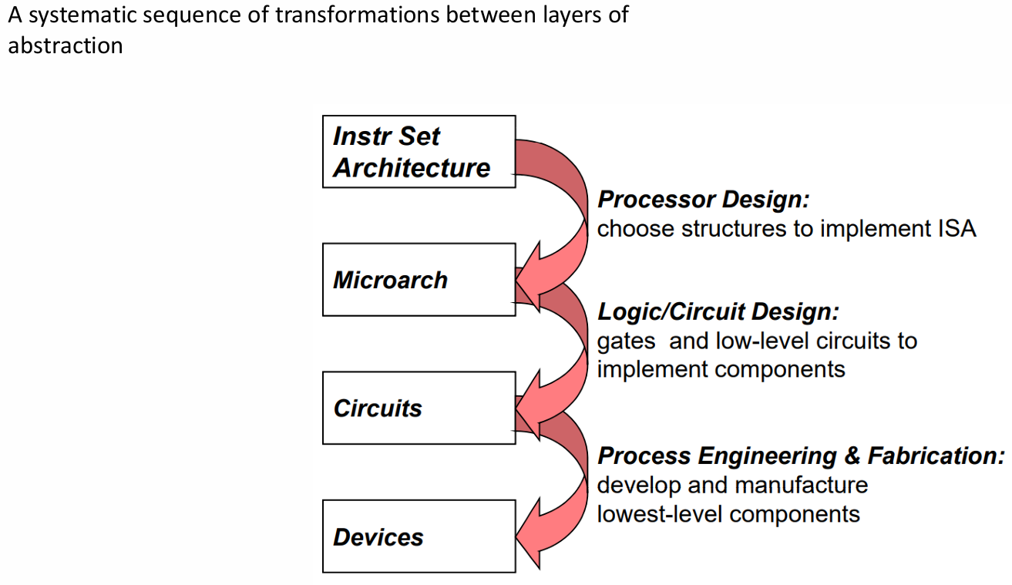
How do we solve a problem using a computer?

Slide 13
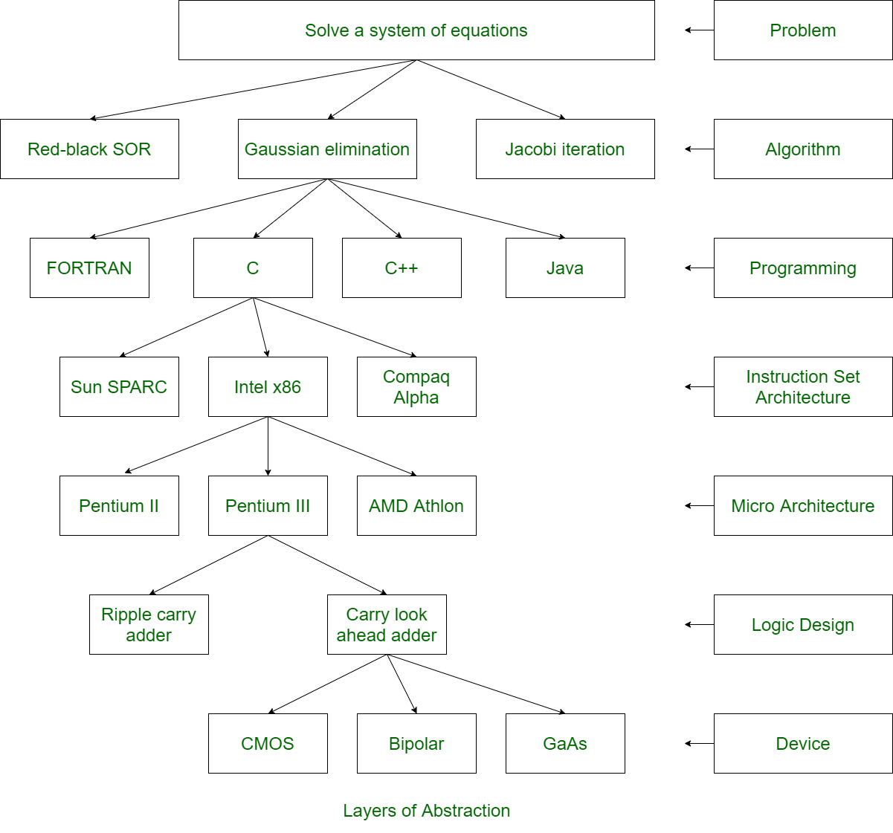

Slide 14
Review questions
Which of the following best captures the meaning of computer architecture?
Which of the following levels of abstraction does computer architecture deal with?
Which of the following statements about microarchitecture is correct?
Which statement correctly reflects the distinction between architecture and implementation?

Slide 15
The design of a computer
Logical or functional design vs implementation
Architecture vs organization
Example:
Should a computer have a ‘multiply’ instruction?
– architecture
Should the multiply instruction be implemented by a special multiply unit or a mechanism that repeatedly uses the adder?
– organization

Slide 16
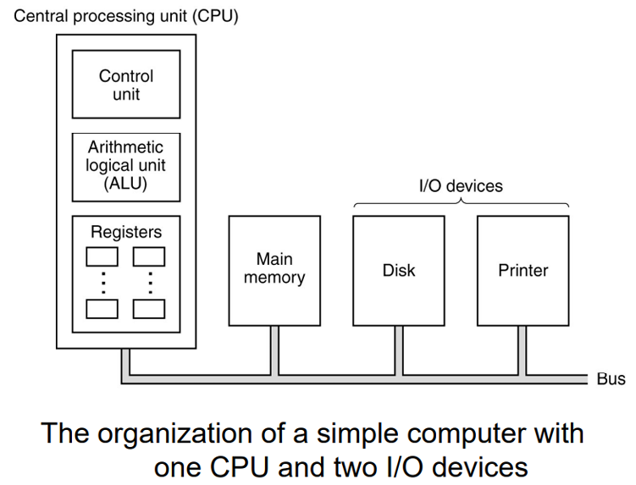
The most common high-level organization – CPU based

Slide 17
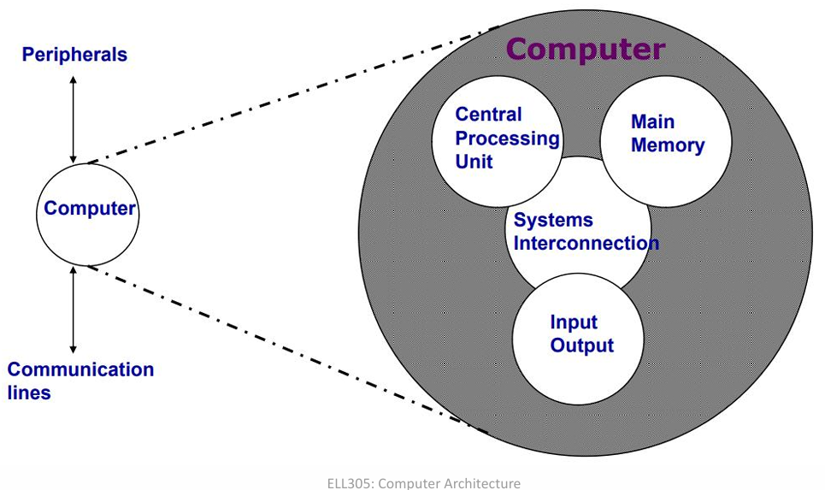
Top-level structure

Slide 18
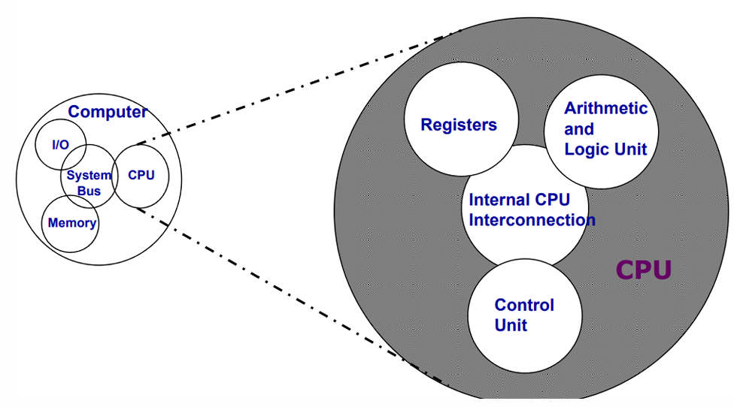
CPU structure

Slide 19
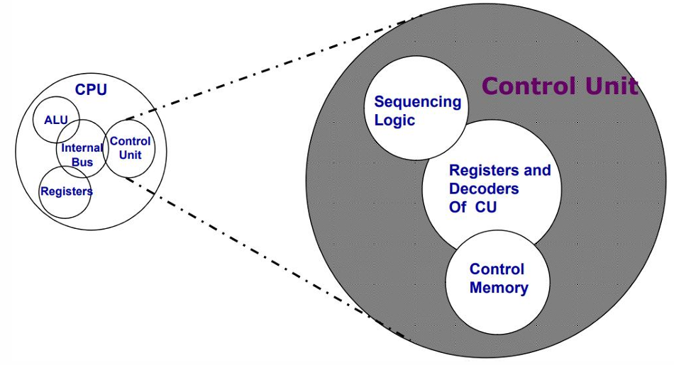
Control unit structure

Slide 20
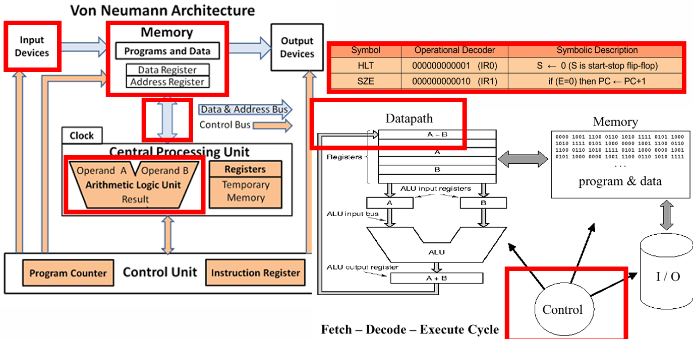
Architecture of a classic modern computer

Slide 21
Key ideas that have shaped computer architecture

Slide 22
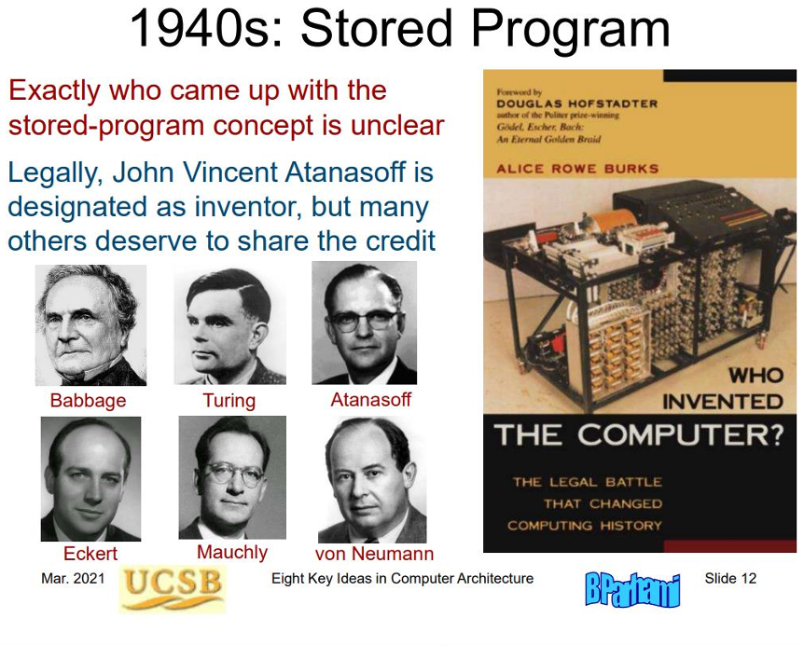

Slide 23
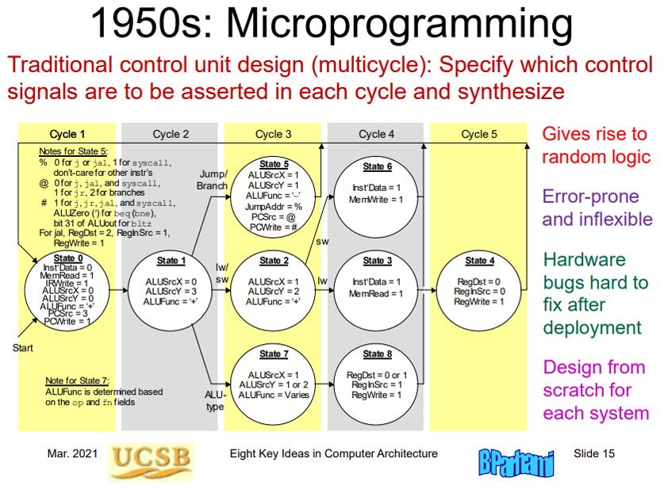

Slide 24
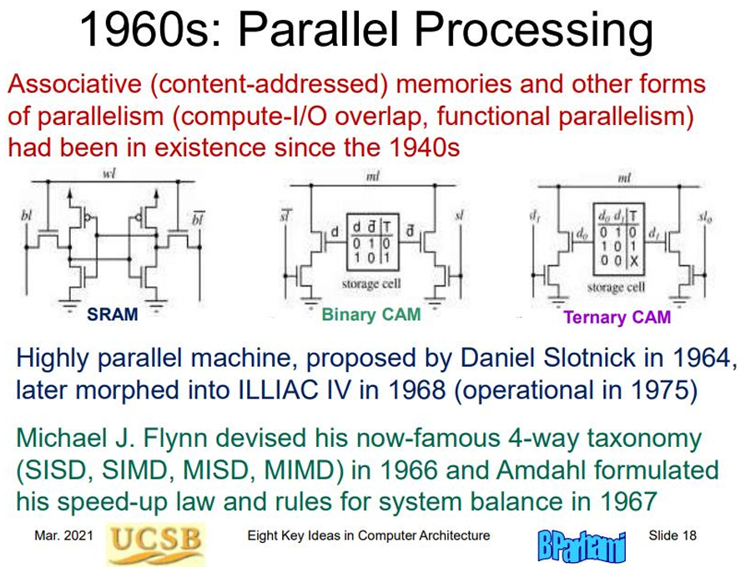

Slide 25
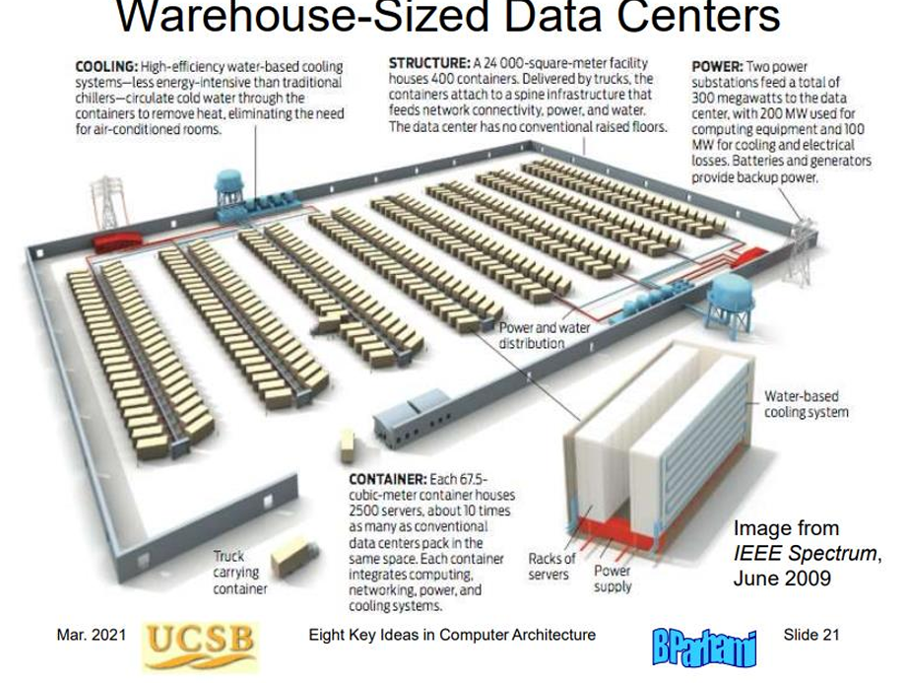
~300 MW power consumption…
~1/10th of peak power consumption of Mumbai

Slide 26
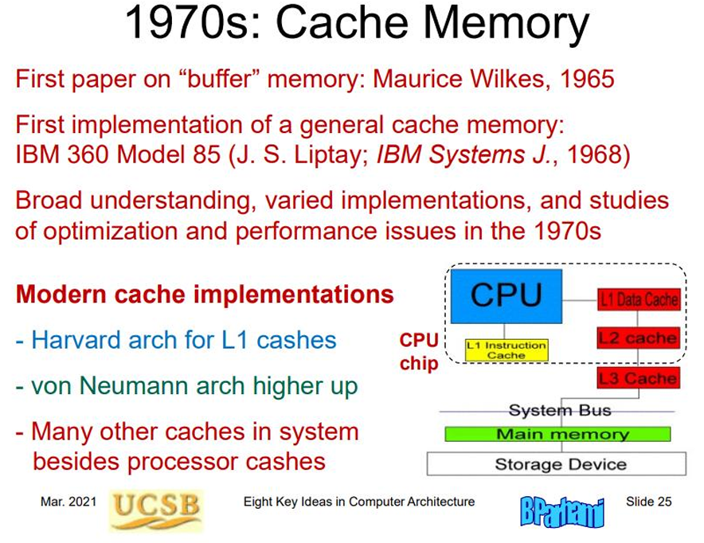

Slide 27
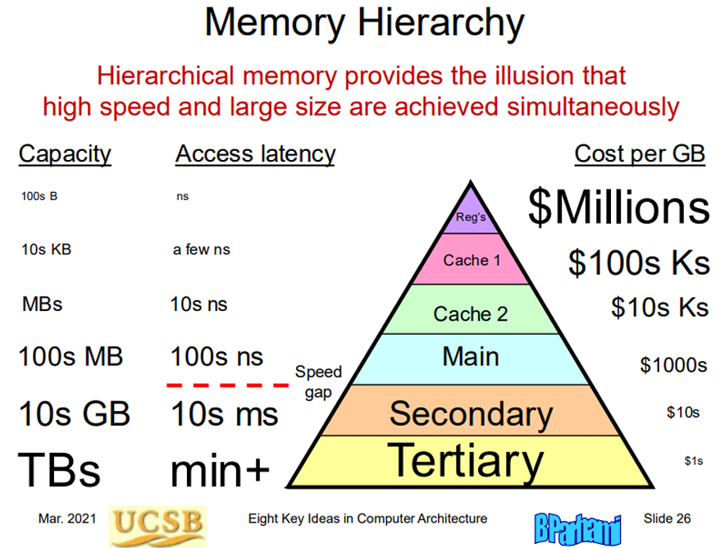

Slide 28
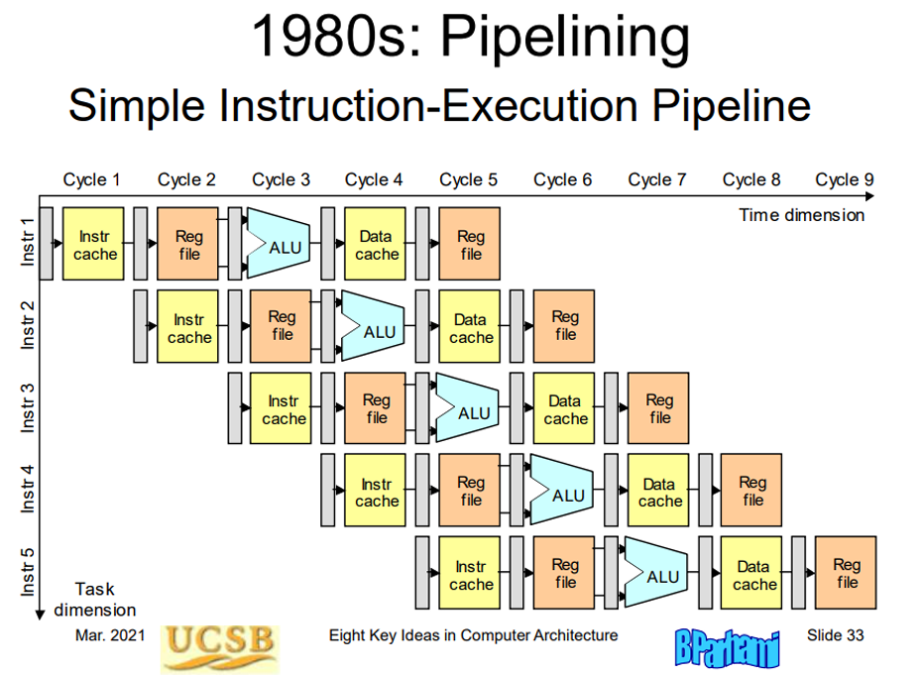

Slide 29
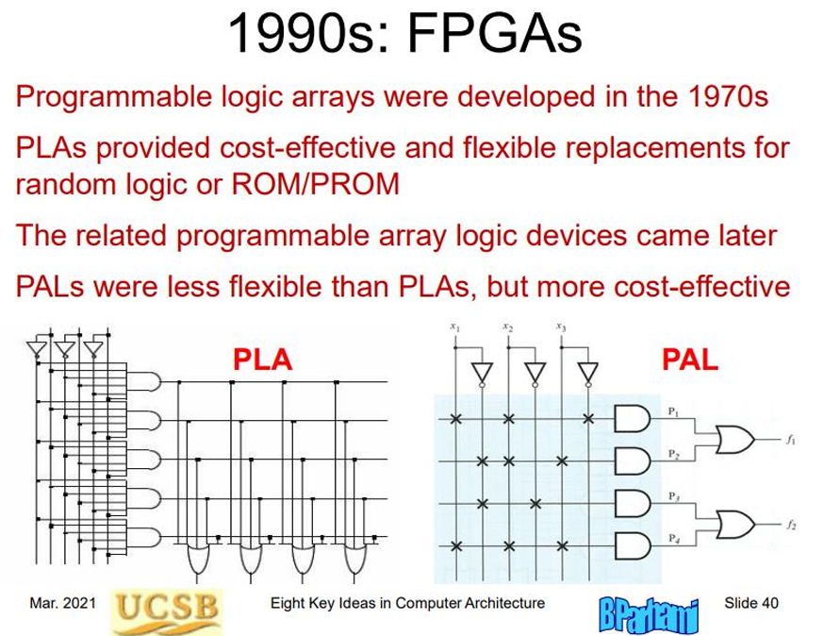

Slide 30
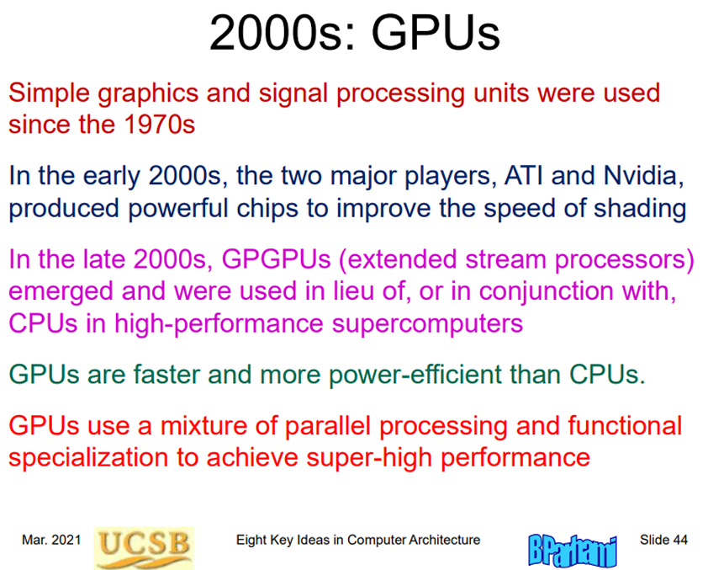

Slide 31
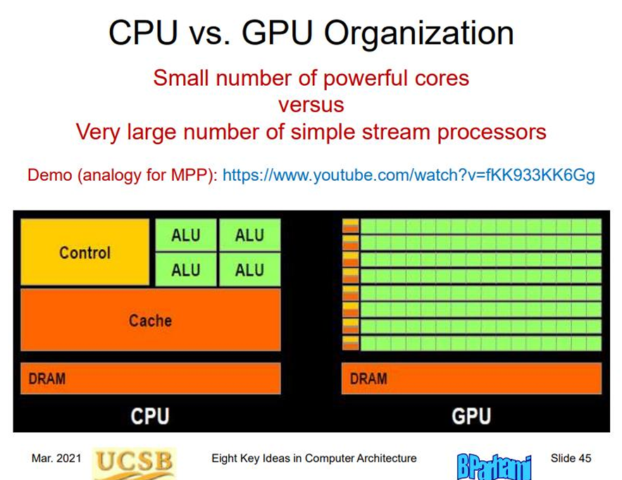

Slide 32
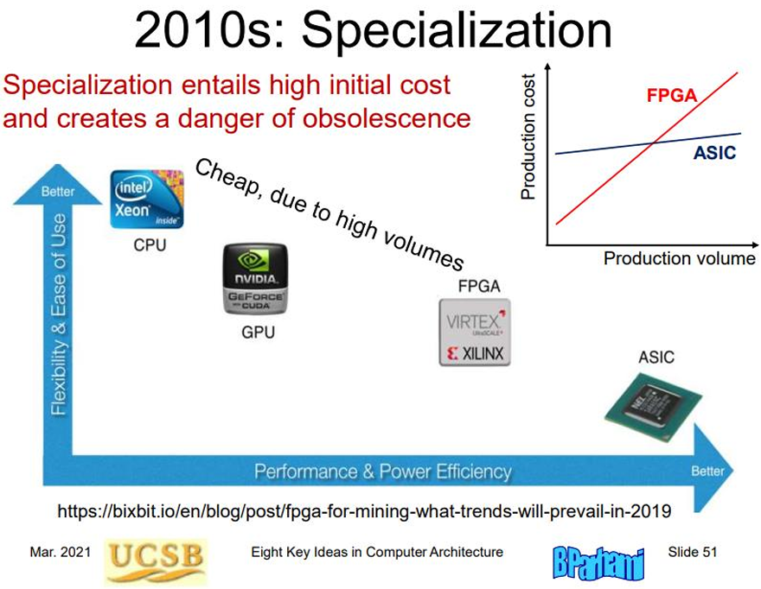

Slide 33
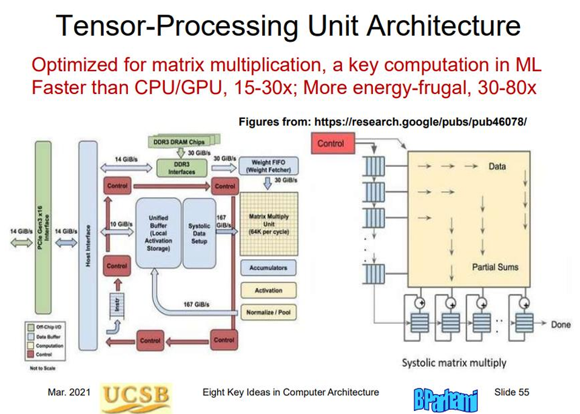

Slide 34
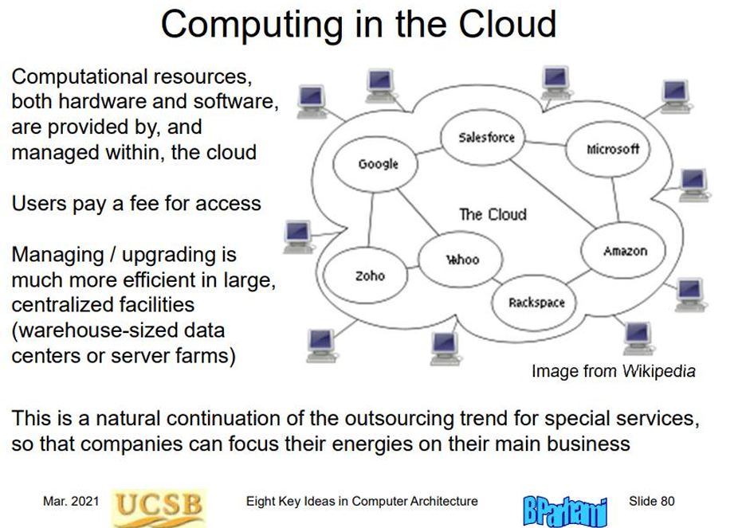

Slide 35
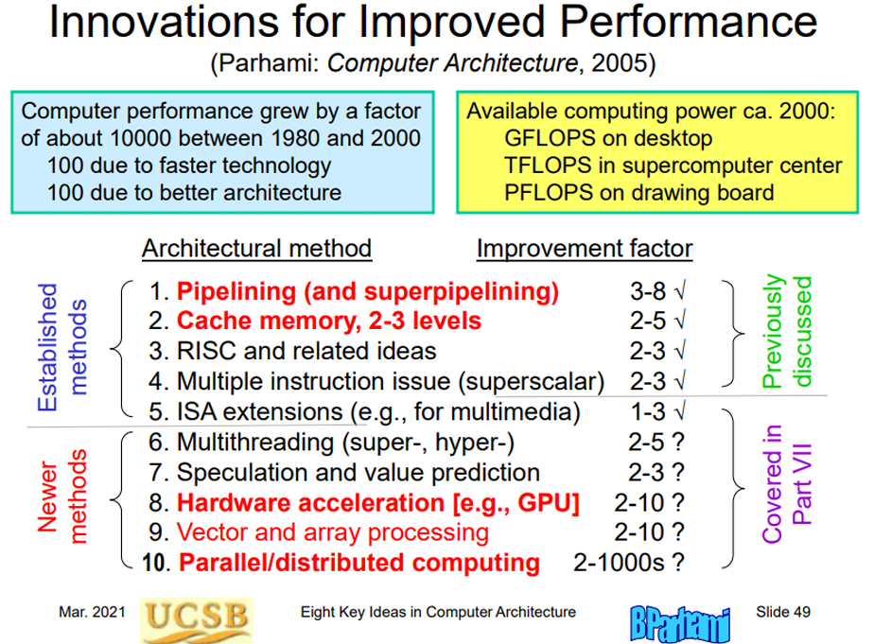

Slide 36
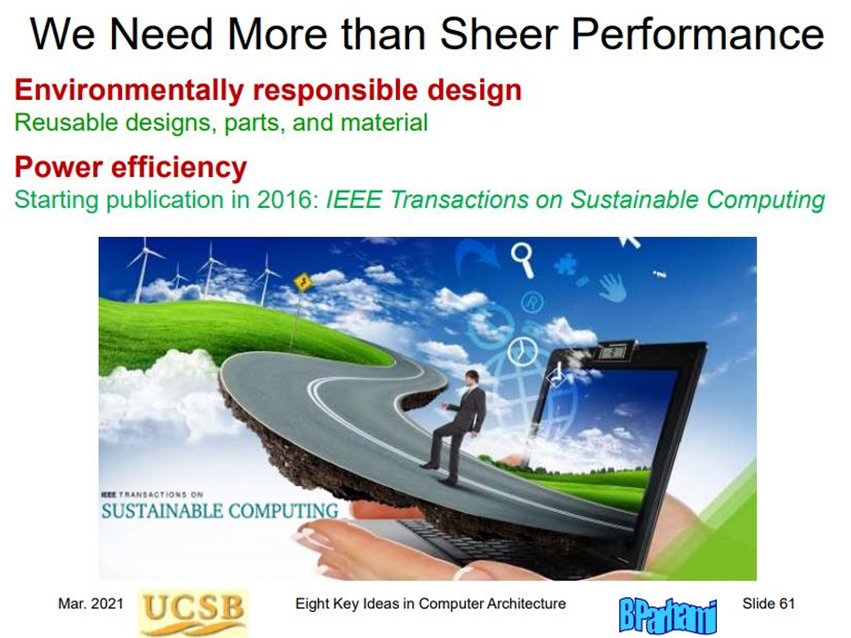

Slide 37
Exciting new technologies
Quantum computing
Bio-inspired / neuromorphic computing
Bringing the “thinking” and the “remembering” functions together into one unit (see here, 5 min read)
Heterogeneous Computing: Dominated by GPU, FPGA, and ASIC Chips (see here, 10 mins, less interesting)
New metrics: security, privacy, reliability, programming paradigms, cloud, edge, real-time (boundable), energy-efficiency

Slide 38
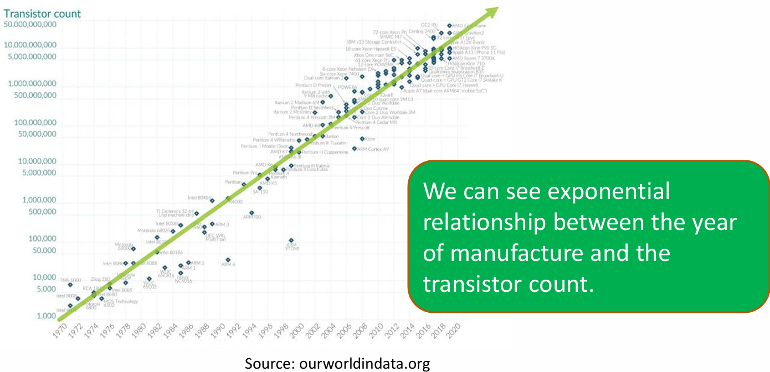
Pushing computers to the limit
Moore’s law: The number of transistors in an integrated circuit will double every two years.

Slide 39

For some inspiration… (try at least the first 20-25 mins)

Slide 40
Some questions to ponder
Does the same program give the same result every time it is run with the same data?
Does it run the same way every time (ie execute the same instructions in the same order)?
How did computers predict branches 20 years ago? How do they do it today?
What is the Moore's law?
Are we close to hitting the limit?
What is the size of a single transistor in modern computers?

Slide 41
Review questions
IC assigning questions…
Compared to RAM memory, registers are…
Large scale parallel processing at architectural level…

